Slide 1
DESIGN AND IMPLEMENTATION OF A MOBILE-BASED ARCHIVAL AND RETRIEVAL OF MISSING OBJECTS APPLICATION USING IMAGE MATCHING
task 3: requirements analysis
Group one

Slide 2
OUTLINE
INTRODUCTION
SYSTEM DESIGN AND MODELLING:
SYSTEM ARCHITECHTURE DESIGN
CONTEXT DIAGRAM
USECASE DIAGRAM
SEQUENCE DIAGRAM
CLASS DIAGRAM
DEPLOYMENT DIAGRAM
CONCLUSION

Slide 3
I. INTRODUCTION
Requirements analysis overview

Slide 4
II. SYSTEM MODELLING AND DESIGN

Slide 5
SYSTEM ARHITECTURE

Slide 6
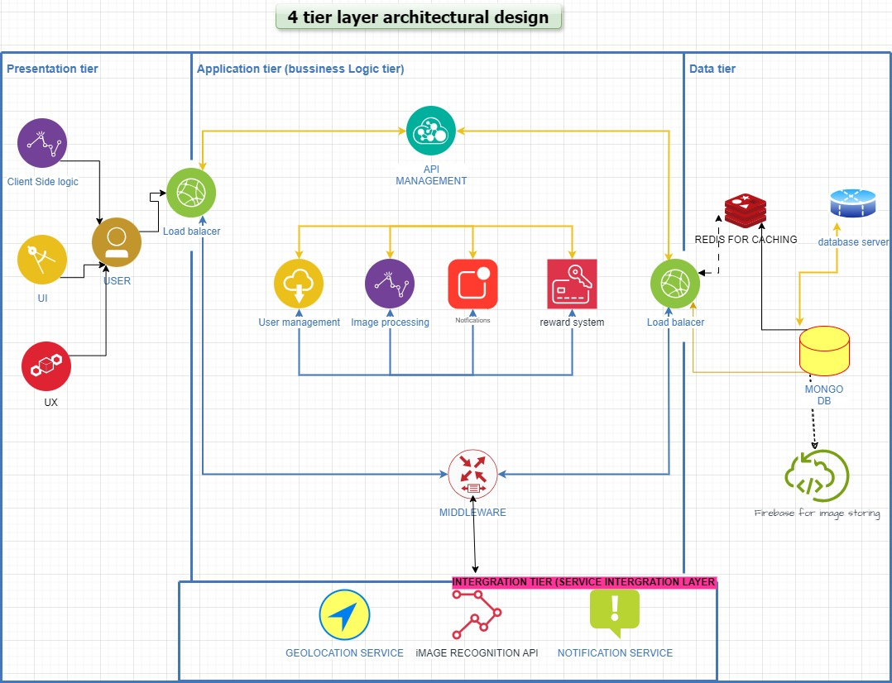

Slide 7
CONTEXT DIAGRAM

Slide 8
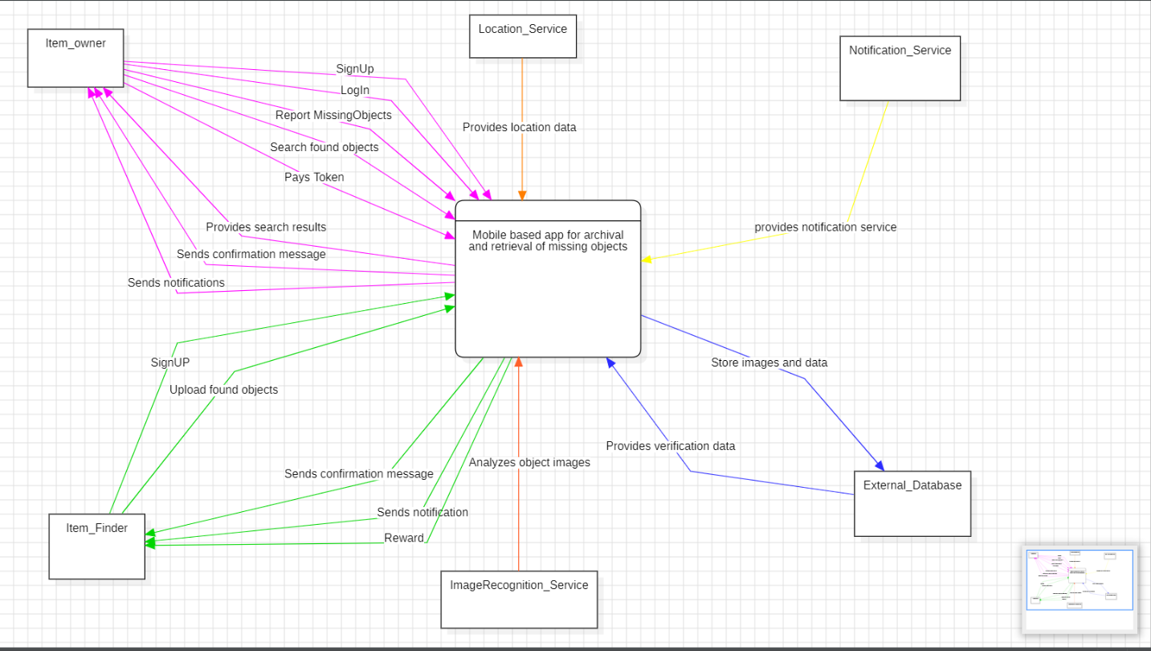

Slide 9
USECASE DIAGRAM

Slide 10
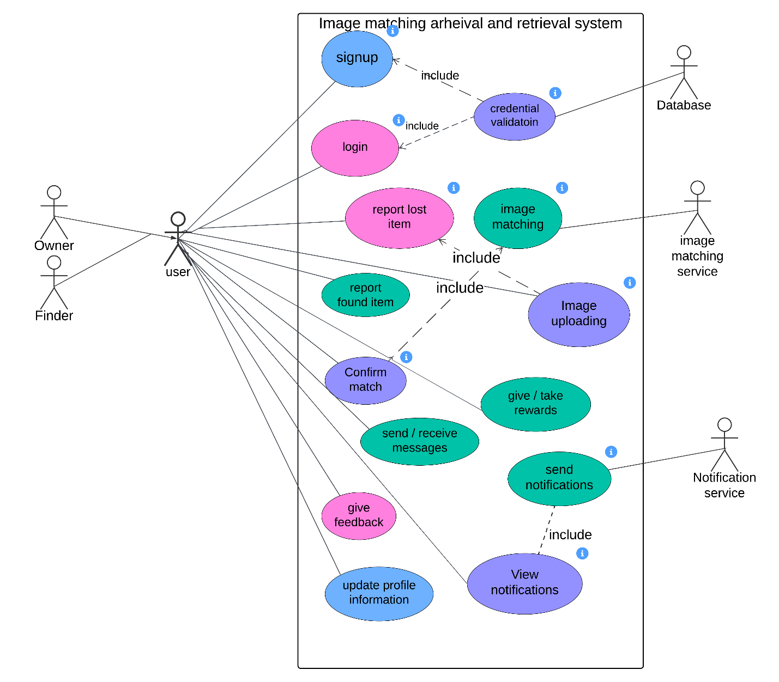

Slide 11
SEQUENCE DIAGRAM

Slide 12
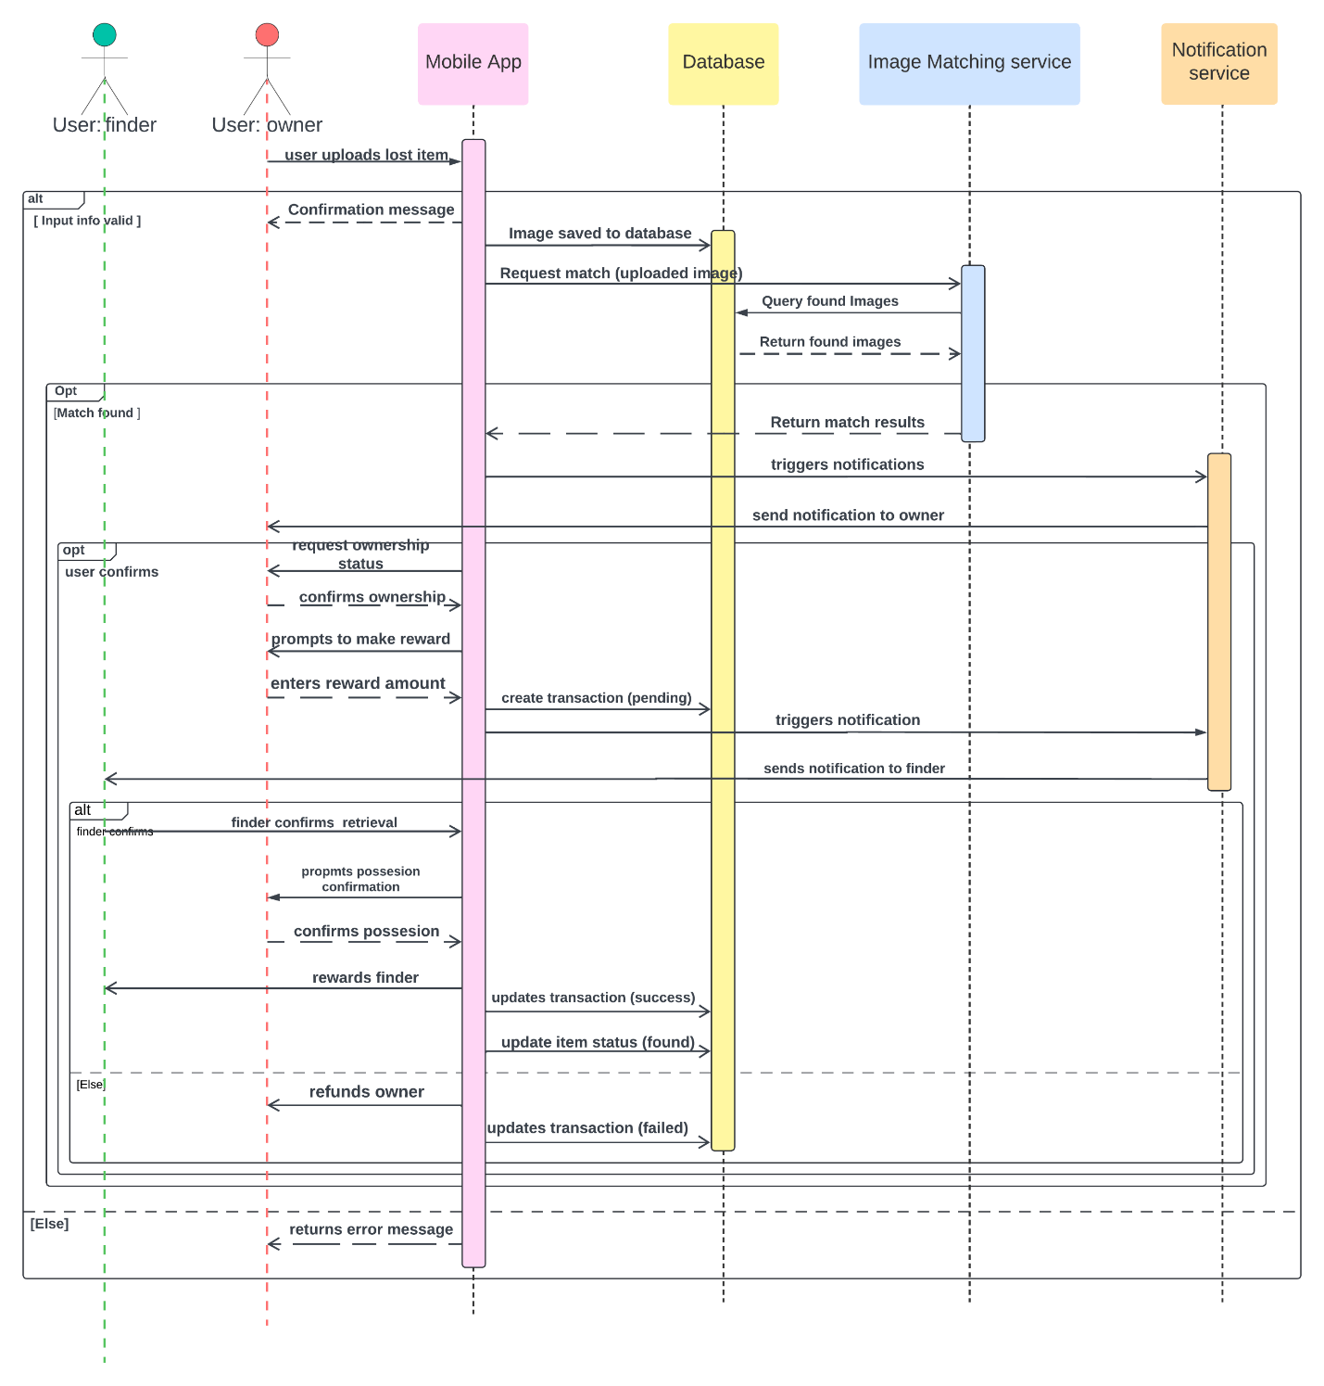

Slide 13
CLASS DIAGRAM

Slide 14
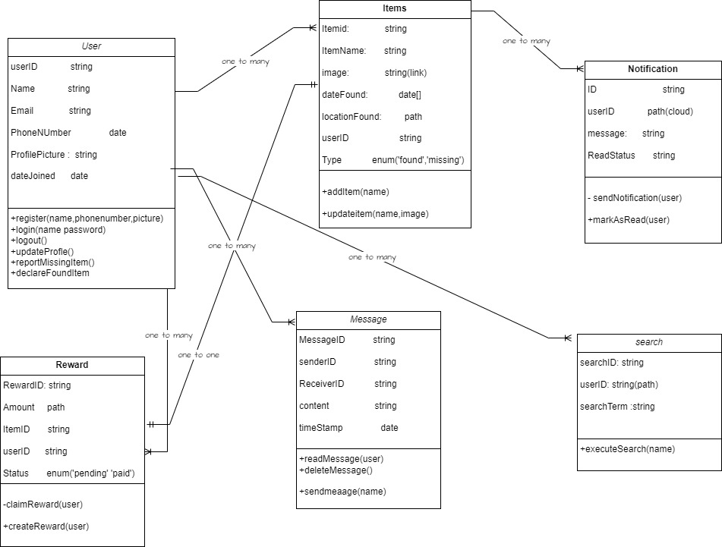

Slide 15
DEPLOYMENT DIAGRAM

Slide 16
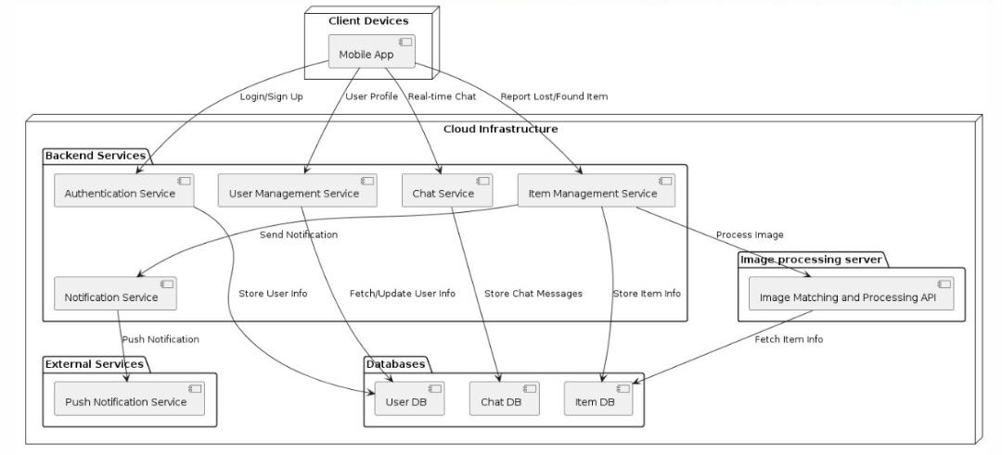

Slide 17
CONCLUSION

Slide 18
THANK YOU

Slide 19
END
NAME | MATRICULE
MEWOABI NGUEFACK DORE | FE21A239
ALEANU NTIMAEH ENOW | FE21A134
OJONG-ENYANG OYERE | FE21A297
FONGANG KELUAM PAUL DIEUDONNE | FE21A193
TANWIE BRUNO ADEY | FE21A316

